Slide 1



Hebwiki-QA NLP Hebrew Question-Answering Model
May Flaster
Matan Ben-Chorin
Supervisor : Oren Mishali
Winter 2022

Slide 2
Outline
Motivation and Introduction
Goals
Dataset Creation
Fine-Tuning heBERT-QA model
Experiments and Results
Future work
Conclusions

Slide 3
What is NLP ?
NLP is a field of linguistics and machine learning focused on understanding everything related to human language.
The aim of NLP tasks is not only to understand single words individually, but to be able to understand the context of those words.

Slide 4
Question-Answering NLP model
What is Question-Answering task in NLP?
Extracting an answer from a text: Given a question and a context, extracting the answer to the question based on the information provided in the context.
This task comes in many flavors, but we focused on extractive question answering.
This involves posing questions about a document and identifying the answers as spans of text in the document itself.

Slide 5
Project Goals
Create an extractive question answering model for the Hebrew language.
Main parts:
Dataset Creation
Fine-Tuning heBERT-QA model

Slide 6
Dataset Creation
SQUAD
Stanford Question Answering Dataset (SQuAD) is a reading comprehension dataset, consisting of questions posed by crowdworkers on a set of Wikipedia articles, where the answer to every question is a segment of text, or span, from the corresponding reading passage, or the question might be unanswerable.

Slide 7
Dataset Creation
In our dataset creation process we were inspired by SOQAL project - Neural Arabic Question Answering - https://github.com/husseinmozannar/SOQAL
Steps
1. Translation
2. Fix Translation
3. Remove bad Translations
4. Adjust To HuggingFace Format

Slide 8
Dataset Creation
1&2 Translation and Fix
Translate contexts, questions and answers with Google Translate API
Fix answer start location in translated context
Remove special characters as punctuation and quotes signs

Slide 9
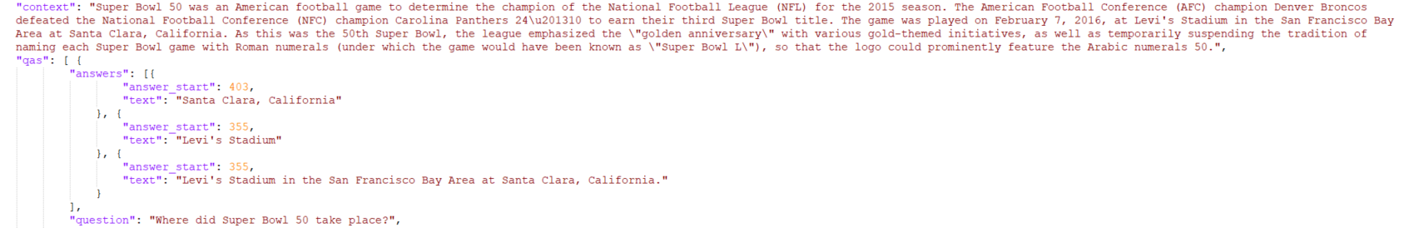
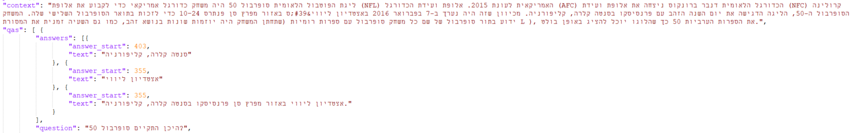
Dataset Creation
1. Translation

Slide 10
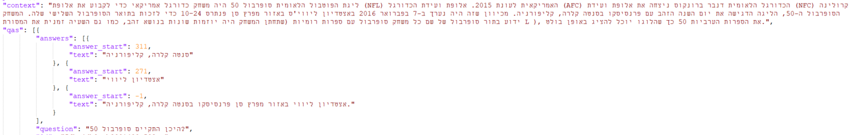
Dataset Creation
2. Fix

Slide 11
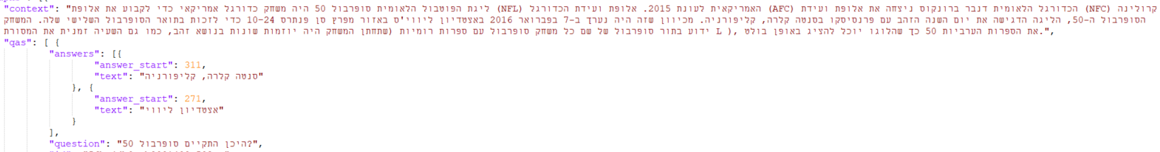
Dataset Creation
3. Remove Bad Translations

Slide 12
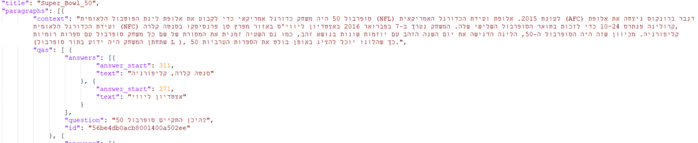
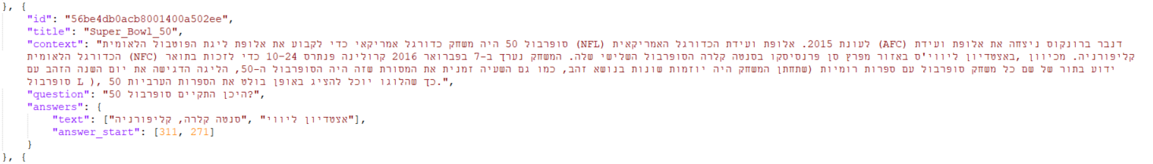
Dataset Creation
4. Adjust To HuggingFace Format

Slide 13
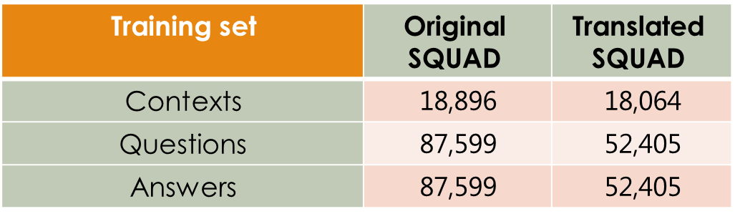
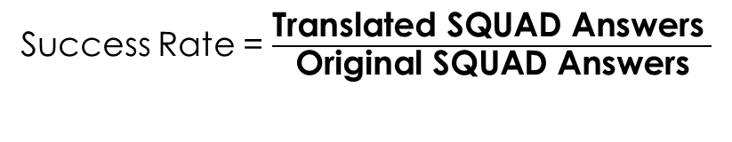
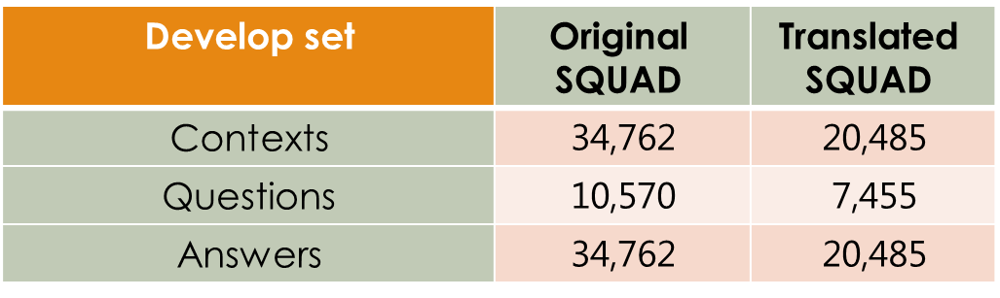
Dataset Creation
Statistics – Dataset Size
Success Rate = $\frac{\text{Translated} \text{SQUAD} \text{Answers} }{\text{Original} \text{SQUAD} \text{Answers}}$
Develop set | Original SQUAD | Translated SQUAD
Contexts | 34,762 | 20,485
$$\text{Questions}$$ | 10,570 | 7,455
Answers | 34,762 | 20,485
Success Rate =58.92%
Training set | Original SQUAD | Translated SQUAD
Contexts | 18,896 | 18,064
$$\text{Questions}$$ | 87,599 | 52,405
Answers | 87,599 | 52,405
Success Rate = 59.82%

Slide 14

Fine-Tuning heBERT-QA model
Our work based on Hugging Face course – Qusetion- answering tutorial – link
Steps
Loading Dataset
Loading Model And Tokenizer
Choosing training arguments
Training
Saving Model
Evaluating Model
Push To Hub

Slide 15
Fine-Tuning heBERT-QA model
Loading Dataset
Load Hebrew SQUAD dataset that we have created
Loading Model And Tokenizer
Load a pre-trained model from Hugging face hub. We chose heBERT -A Hebrew pretrained language model based on Google's BERT architecture.

Slide 16
Loading Model And Tokenizer
At first, we tried to use AlephBERT: State-of-the-art language model for Hebrew, based on Google's BERT architecture
AlephBert wasn’t trained on NSP tasks (Next sentence prediction) and it caused incompatibility problem between the configuration parameters.
We took HeBERT instead, another Hebrew pretrained language model based on Google's BERT architecture. It was trained on smaller dataset, but does support our task’s requirements

Slide 17
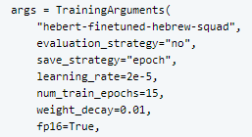
Fine-Tuning heBERT-QA model
Choosing training arguments & Training
We tried different parameters. Such as: Learning_rate from 1e-5 to 3e-5, Num_train_epochs from 1 to 15 and more. We chose the best parameters that maximizes our performance on the validation dataset.
Saving Model
After training ends, we want to save the new model for evaluation and further use.

Slide 18
Experiments and Results
The F1 score is the harmonic mean of the precision and recall. It can be computed with: F1 = 2 * (precision * recall) / (precision + recall).
Our model achieved ‘f1 score ‘= 55.896% and ‘exact_match score’= 42.602% on validation dataset .
Let’s see some interesting examples

Slide 19
Experiments and Results
New example (not familiar to the model):
context = "כרמלית היא כלי תחבורה ציבורית תת-קרקעי, היחיד בישראל. הכרמלית מחברת בין שלושה אזורים מרכזיים בעיר חיפה: העיר התחתית, שכונת הדר ומרכז הכרמל. לכרמלית קו בודד ובו שש תחנות פעילות, היא מופעלת על ידי חברת הכרמלית חיפה בעמ. הקמתה של הכרמלית החלה במאי 1956 והסתיימה במרץ 1959. בניגוד לתפיסה הרווחת, לפיה הכרמלית היא רכבת תחתית, אין היא אלא פוניקולר, רכבל הנע על מסילה במקום להיות תלוי באוויר. שלא כמו רכבת, אין בקרונות הכרמלית מנוע, ומשקלם של הקרונות היורדים הוא הכוח העיקרי המניע את הקרונות העולים (מנוע בתחנת הקצה העליונה תורם אף הוא כוח הנעה)."
question = "מתי הוקמה הכרמלית?"“ 'score': 1.0, 'start': 240, 'end': 249, 'answer': 'במאי 1956'
question = "כמה תחנות יש בכרמלית?" 'score': 0.9999990463256836, 'start': 160, 'end': 162, 'answer': 'שש

Slide 20
Experiments and Results
Translated example – from the validation dataset:
context = ""בניין רחוב הצליינים שופץ בין נובמבר 2006 למאי 2008; במהלך עבודות השיפוץ, בית הקולנוע עבר לבית העירייה הישן, גייטסהד. במאי 2008 נפתח מחדש בית הקולנוע Tyneside בבניין המקורי המשוחזר והמשופץ. האתר מכיל כיום שלושה בתי קולנוע, כולל הקלאסי המשוחזר - קולנוע החדשות האחרון ששרד בבריטניה שעדיין פועל במשרה מלאה - לצד שני מסכים חדשים, הרחבת גג המכילה את ה-Tyneside Bar, וסוויטות חינוך והוראה ייעודיות.""
question = ""כמה בתי קולנוע שוכנים כיום באתר אחד?"“ 'score': 1.0, 'start’:205, 'end’:210, 'answer': '"שלושה
question = "לאן הועבר בית קולנוע בזמן התיקונים?" 'score’:1.0, 'start’:109, 'end’:116 , 'answer': 'גייטסהד’

Slide 21
More examples in:
https://github.com/TechnionTDK/hebwiki-qa/blob/master/finetuning_hebert/example.py

Slide 22

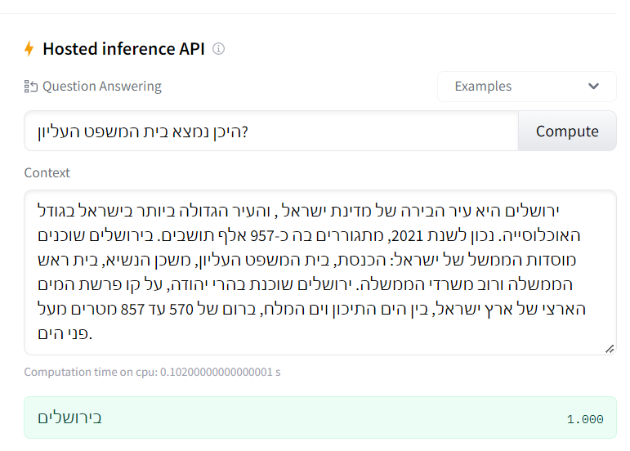
Try it yourself! Our Model on Hugging face Hub
Link: https://huggingface.co/tdklab/hebert-finetuned-hebrew-squad

Slide 23
Hebrew SQuAD on Hugging face Hub
Link: https://huggingface.co/datasets/tdklab/Hebrew_Squad_v1.1
** TODO - image from dataset preview

Slide 24
Future work
Improve the dataset Including manual testing and adding question-answer pairs that originally written in Hebrew and not translated.
Examine more parameters of training and try to improve the model performance.
Examine more pre-trained Hebrew models when they are available

Slide 25
Conclusions
This project provided an excellent learning opportunity in the fields of machine learning and data science.
We became familiar with Python and new tools such as hpc, the Hugging face platform, transformers, and etc.
We learnt how to deal with the many obstacles that come with processing data in Hebrew language.
We have developed a product that works from end to end and achieves an amazing outcome that exceeds our expectations.

Slide 26
Project Repository
https://github.com/TechnionTDK/hebwiki-qa

Slide 27


Slide 28


